Slide 1
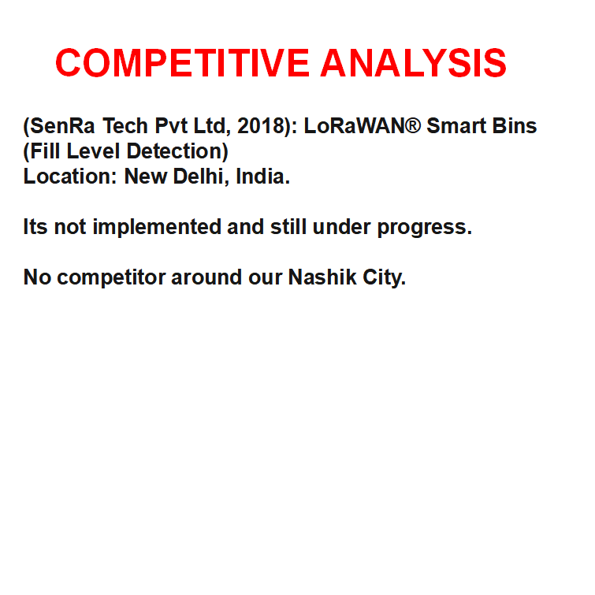

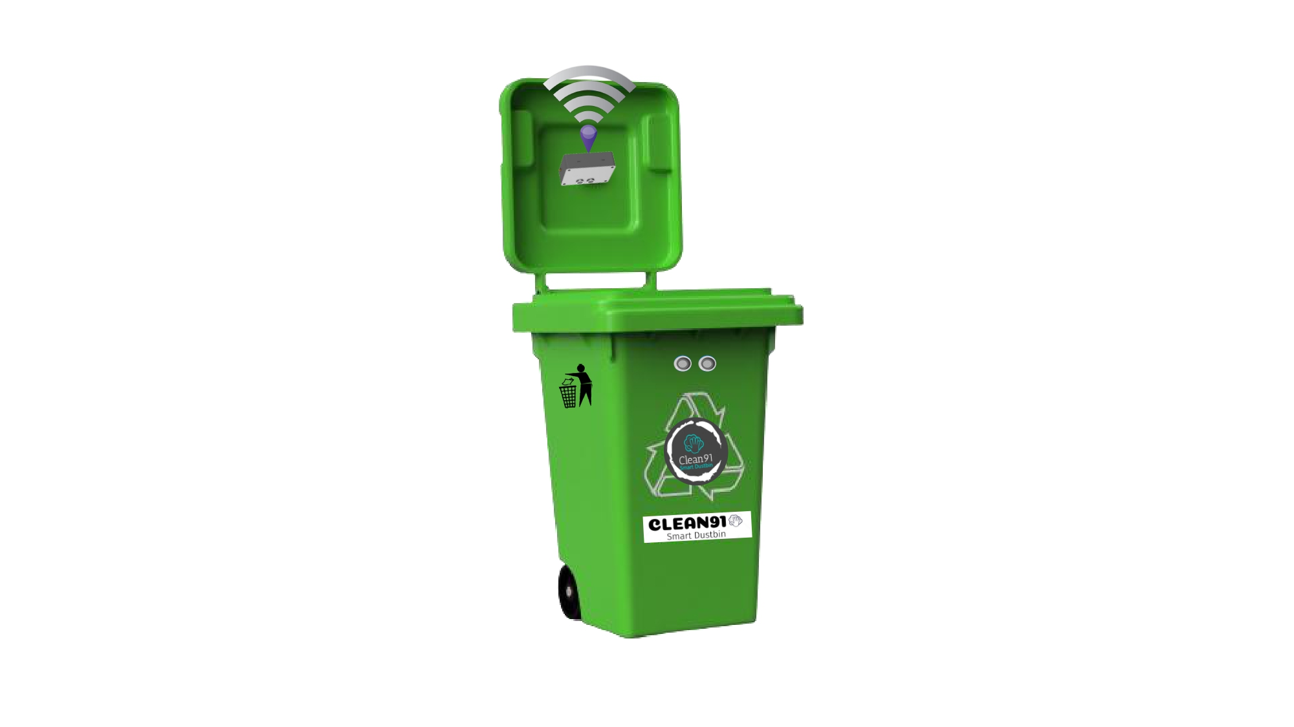


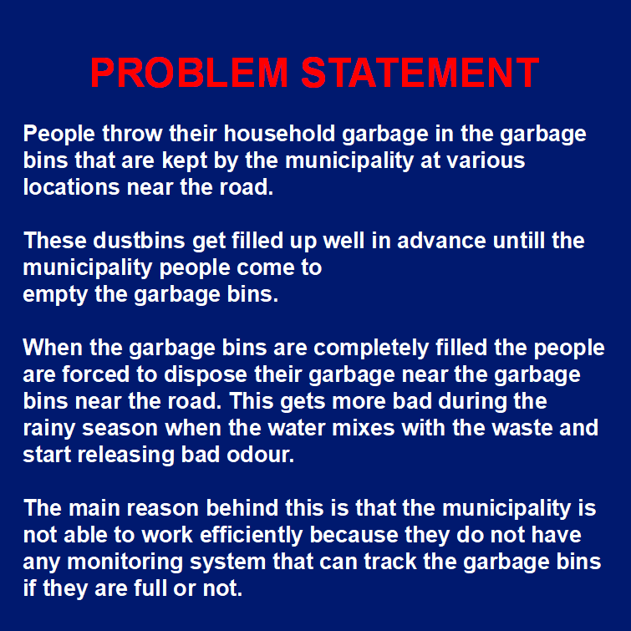




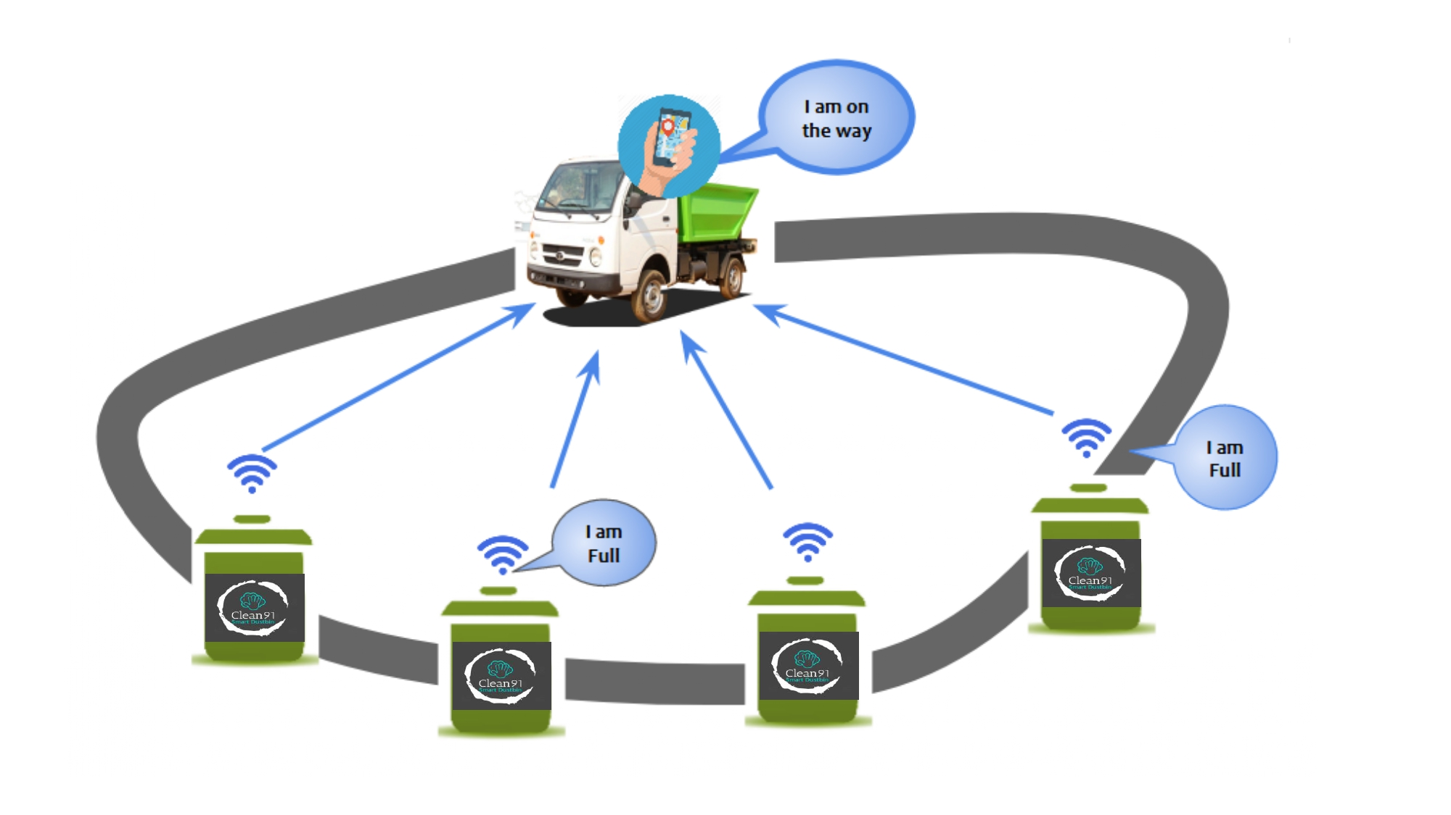
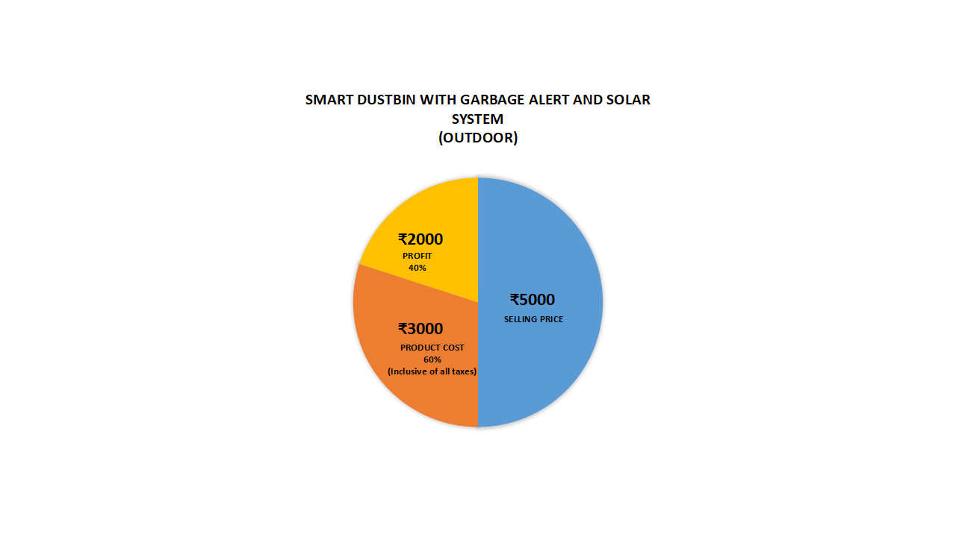


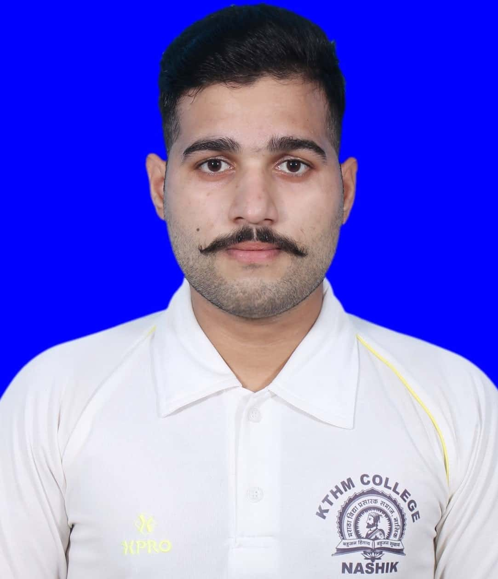



v
(Smart Dustbins for Smart Cities )
CONCEPT
FUNDING
SANJEET KUMAR
(FOUNDER) TYBSc-Electronics
KTHM College,Nashik
BUSINESS MAIL
missionclean91@gmail.com

